Slide 1
Data Structures
& Algorithms
DSA

Slide 2
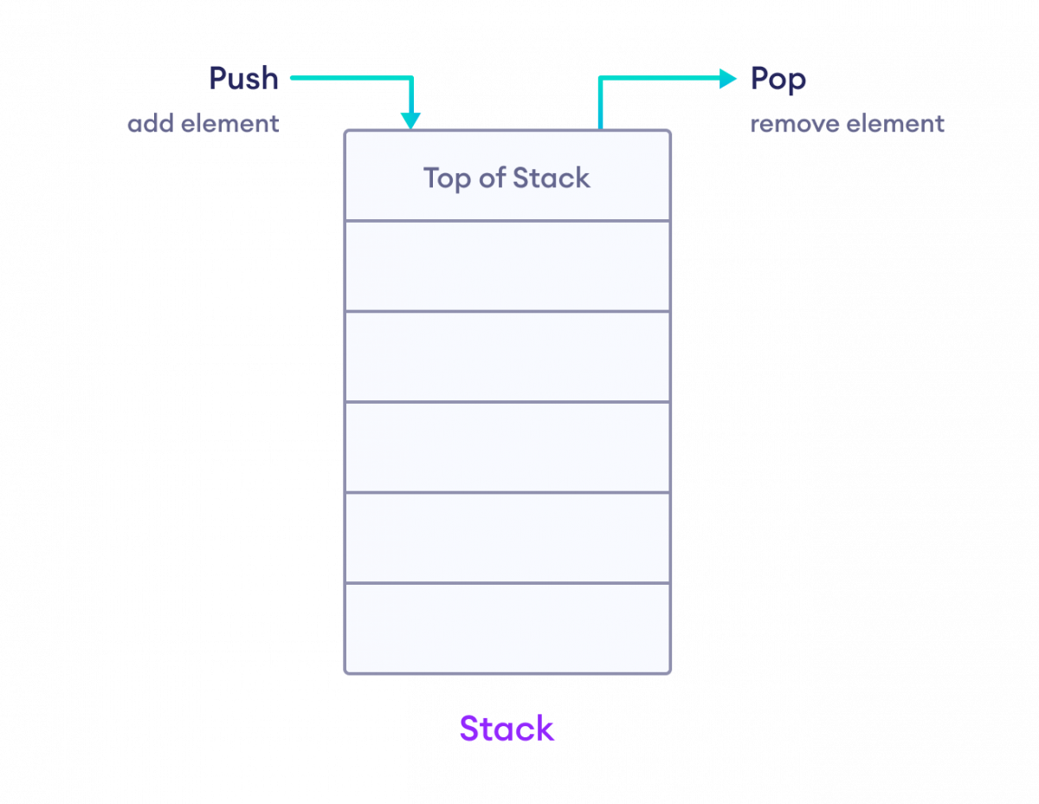
STACKS
A stack stores multiple elements in a specific order, called LIFO.
LIFO stands for Last in, First Out. To vizualise LIFO, think of a pile of pancakes, where pancakes are both added and removed from the top. So when removing a pancake, it will always be the last one you added. This way of organizing elements is called LIFO in computer science and programming.

Slide 3
STACKS IN C++
Since elements are added and removed from the top, you can only access the element at the top of the stack.
Stack uses an encapsulated object of either vector or deque (by default) or list (sequential container class) as its underlying container, providing a specific set of member functions to access its elements.
To use a stack, you have to include the <stack> header file:
// Include the stack library
#include <stack>
Notes:
Thinking Humanly: Cognitive Modeling
Cognitive Modeling: This approach is about understanding how humans think and then trying to create a program that thinks the same way.
How do we do this? Scientists study human thought through things like introspection (thinking about how we think), experiments, and brain imaging.
Example: A computer program designed to solve puzzles in the same steps and manner a human would.

Slide 4
Operations on Stack
We can perform the following operations on a stack
Create a Stack
Insert elements in a stack
Access the elements of a stack
Delete elements in a stack
Get the size of the stack

Slide 5
Create a Stack
To create a stack, use the stack keyword, and specify the type of values it should store within angle brackets <> and then the name of the stack, like: stack<type> stackName.
// Create a stack of strings called cars
stack<string> cars;

Slide 6
Create a Stack
Note: The type of the stack (string in our example) cannot be changed after its been declared.
Note: You cannot add elements to the stack at the time of declaration, like you can with vectors:
stack<string> cars = {"Volvo", "BMW", "Ford", "Mazda"};

Slide 7
Add Elements
To add elements to the stack, use the .push() function, after declaring the stack:
// Create a stack of strings called cars
stack<string> cars;
// Add elements to the stack
cars.push("Volvo");
cars.push("BMW");
cars.push("Ford");
cars.push("Mazda");
The stack will look like this (remember that the last element added is the top element):
Mazda (top element)
Ford
BMW
Volvo

Slide 8
Access Stack Elements
You cannot access stack elements by referring to index numbers, like you would with arrays and vectors.
In a stack, you can only access the top element, which is done using the .top() function:
Example:
// Access the top element
cout << cars.top(); // Outputs "Mazda"

Slide 9
Change the Top Element
You can also use the .top function to change the value of the top element:
Example:
// Change the value of the top element
cars.top() = "Tesla";
// Access the top element
cout << cars.top(); // Now outputs "Tesla" instead of "Mazda"

Slide 10
Remove Elements
You can use the .pop() function to remove an element from the stack.
This will remove the last element that was added to the stack:
// Create a stack of strings called cars
stack<string> cars;
// Add elements to the stack
cars.push("Volvo");
cars.push("BMW");
cars.push("Ford");
cars.push("Mazda");
// Remove the last added element (Mazda)
cars.pop();
// Access the top element (Now Ford)
cout << cars.top();

Slide 11
Get the Size of the Stack
To find out how many elements a stack has, use the .size() function:
Example:
cout << cars.size();

Slide 12
Stacks
stack<string> cars;
cars.push("Volvo");
cars.push("BMW");
cars.push("Ford");
cars.push("Mazda");
cout << cars.empty();

Slide 13
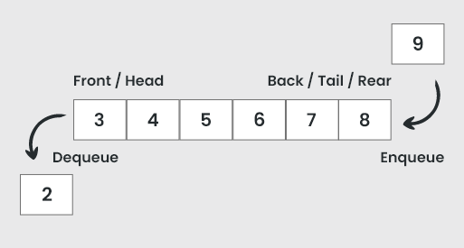
QUEUES
A queue stores multiple elements in a specific order, called FIFO.
FIFO stands for First in, First Out. To visualize FIFO, think of a queue as people standing in line in a supermarket. The first person to stand in line is also the first who can pay and leave the supermarket. This way of organizing elements is called FIFO.

Slide 14
QUEUES IN C++
Queues are a type of container adaptors that operate in a first in first out (FIFO) type of arrangement. Elements are inserted at the back (end) and are deleted from the front. Queues use an encapsulated object of deque or list (sequential container class) as its underlying container, providing a specific set of member functions to access its elements.
To use a Queue, you have to include the <queue> header file:
// Include the Queue library
#include <queue>
Notes:
Thinking Humanly: Cognitive Modeling
Cognitive Modeling: This approach is about understanding how humans think and then trying to create a program that thinks the same way.
How do we do this? Scientists study human thought through things like introspection (thinking about how we think), experiments, and brain imaging.
Example: A computer program designed to solve puzzles in the same steps and manner a human would.

Slide 15
Operations on Queues
We can perform the following operations on a queue
Create a Queue
Insert elements in a Queue
Access the elements of a Queue
Change front and back elements of a Queue
Delete elements in a Queue
Get the size of the Queue

Slide 16
Create a Queue
To create a queue, use the queue keyword, and specify the type of values it should store within angle brackets <> and then the name of the queue, like: queue<type> queueName.
// Create a queue of strings called cars
queue<string> cars;

Slide 17
Create a Queue
Note: The type of the queue (string in our example) cannot be changed after its been declared.
Note: You cannot add elements to the queue at the time of declaration, like you can with vectors:
queue<string> cars = {"Volvo", "BMW", "Ford", "Mazda"};

Slide 18
Add Elements
To add elements to the queue, you can use the .push() function after declaring the queue.
The .push() function adds an element at the end of the queue:
// Create a queue of strings
queue<string> cars;
// Add elements to the queue
cars.push("Volvo");
cars.push("BMW");
cars.push("Ford");
cars.push("Mazda");
Volvo (front (first) element)
BMW
Ford
Mazda (back (last) element)

Slide 19
Access Queue Elements
You cannot access queue elements by referring to index numbers, like you would with arrays and vectors.
In a queue, you can only access the element at the front or the back, using .front() and .back() respectively:
// Access the front element (first and oldest)
cout << cars.front(); // Outputs "Volvo"
// Access the back element (last and newest)
cout << cars.back(); // Outputs "Mazda"

Slide 20
Change Front and Back Elements
You can also use .front and .back to change the value of the front and back elements:
Example:
// Change the value of the front element
cars.front() = "Tesla";
// Change the value of the back element
cars.back() = "VW";
// Access the front element
cout << cars.front(); // Now outputs "Tesla" instead of "Volvo"
// Access the back element
cout << cars.back(); // Now outputs "VW" instead of "Mazda"

Slide 21
Remove Elements
You can use the .pop() function to remove an element from the queue.
This will remove the front element (the first and oldest element that was added to the queue):
// Create a queue of strings
queue<string> cars;
// Add elements to the queue
cars.push("Volvo");
cars.push("BMW");
cars.push("Ford");
cars.push("Mazda");
// Remove the front element (Volvo)
cars.pop();
// Access the front element (Now BMW)
cout << cars.front();

Slide 22
Get the Size of the Queue
To find out how many elements there are in a queue, use the .size() function:
Example:
cout << cars.size();

Slide 23
CHECK for empty QUEUE
Use the .empty() function to find out if the queue is empty or not.
The .empty() function returns 1 (true) if the queue is empty and 0 (false) otherwise:
Example:
queue<string> cars;
cout << cars.empty(); // Outputs 1 (The queue is empty)

Slide 24
QUEUES
queue<string> cars;
cars.push("Volvo");
cars.push("BMW");
cars.push("Ford");
cars.push("Mazda");
cout << cars.empty(); // Outputs 0 (not empty)

